Slide 1


Slide 2
We used to be:
A ‘traditional’ social service agency running on instinct and intuition
Our workforce was representative of the sector – no better, no worse
We measured performance with outputs only

Slide 3
Our values:
We wanted to be strengths-based
We wanted to be client-focussed
We wanted to create meaningful change

Slide 4
We Discovered PCOMS
PCOMS fit with our values
Enabled us to put our values into practice
  Work in a truly strengths-based manner
  Put the client at the centre of the work and give the client a powerful voice
  Create change that is meaningful and measurable
We decided to implement PCOMS…

Slide 5
Resistance to Change
Confronting for workers not used to ‘being seen’
Didn’t fit with the traditional dependency model of social work
Seen by workers as an imposition
Some staff churn as a result
But remaining staff began to use it…

Slide 6
How were we going?
Social workers said it was working well
Self-reporting through practice meetings and supervision
Stories of success began to emerge…
But we had know way of knowing for certain if we were using PCOMS effectively across our practice
… so we developed what became QualityWorks

Slide 7
Uncomfortable Truths
CMS now included PCOMS module
Monitored a single thing – ORS
Discovery – less than 30% application rate
Exploration of why?

Slide 8
Resistance to Change 2.0
What’s going on?
More training – getting buy-in?
More overt resistance.
Tried to provide solutions for each negative scenario – made it worse.

Slide 9
KPIs and monitoring
Some staff loss
What we discovered
This is how we do it – expectation
Increased training
Focussed practice meeting and case review

Slide 10
Quality Works
From Friendly Helpers to Skilled Professionals
A language to describe our practice
We know why we are doing what we are doing
Creates Confidence
Shows our work to others

Slide 11
Quality Works Components
Programme Documents
Assessment & Formulation
Client Plans
Client Management Software
Partners for Change OMS
Management Information Software
Key Performance Indicators
Research & Data Mining
Practice Oversight

Slide 12
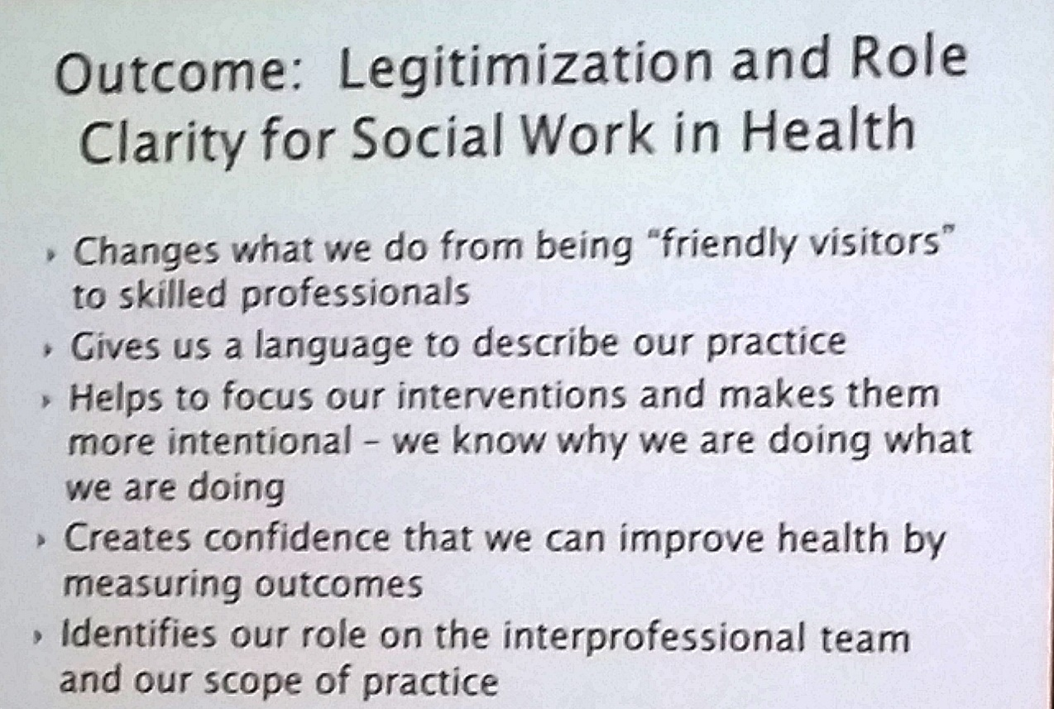

Slide 13
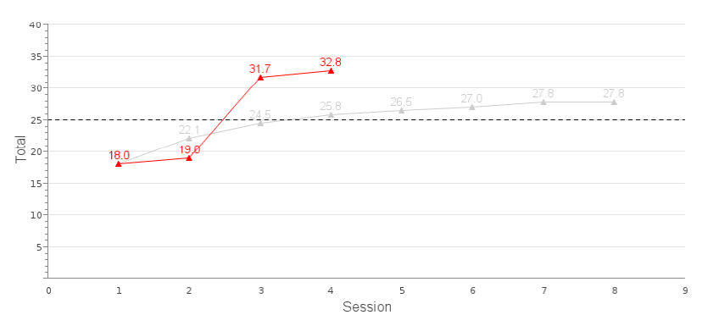
What does QualityWorks
monitoring look like?

Slide 14
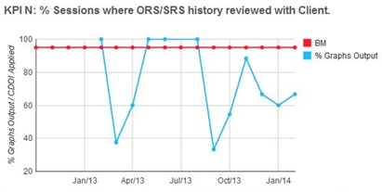
Notes:
[Charles]

Slide 15
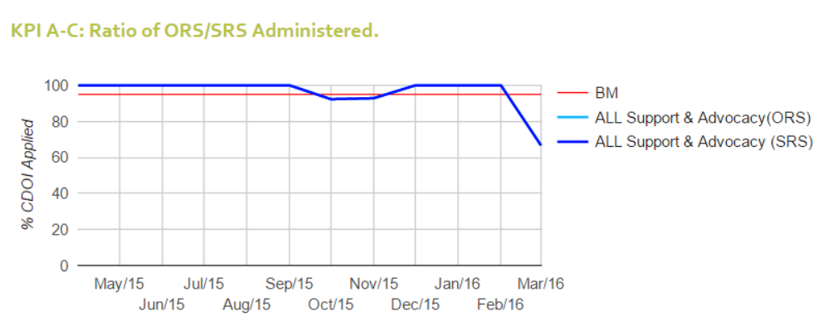
Notes:
[Charles]

Slide 16
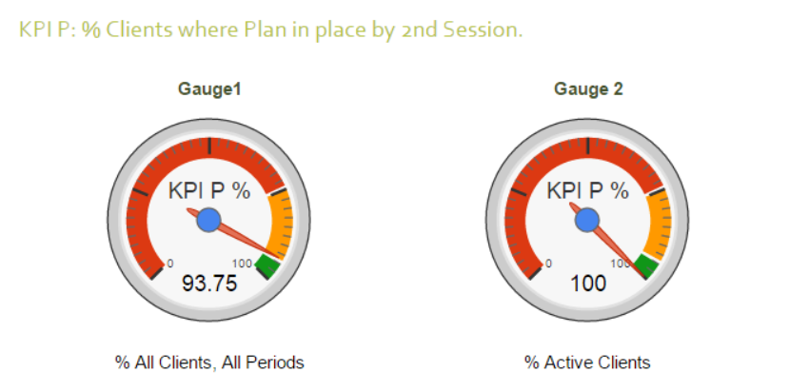
Notes:
[Charles]

Slide 17
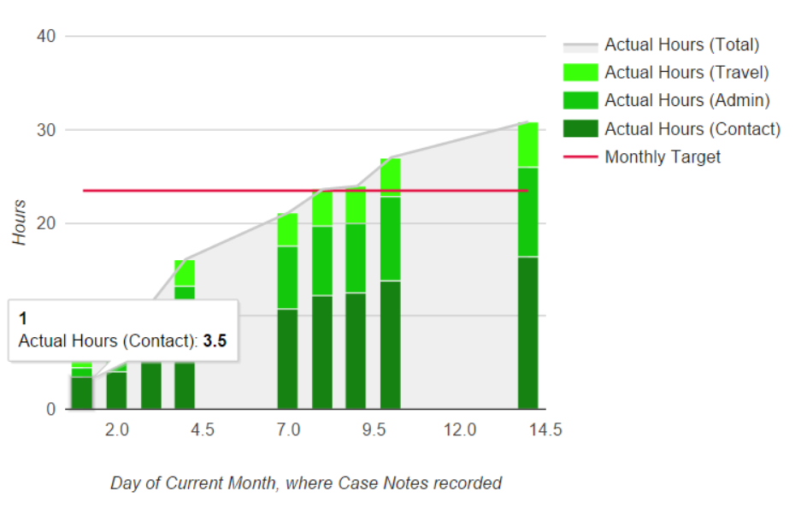
Notes:
[Charles]

Slide 18
How To Make Data Work
Do it all at once – measure and monitor
Initial resistance quickly disappears once the benefits are obvious
Staff churn may occur, but this can be a positive
Improving services for clients is the priority

