Slide 1
Using evidence to address inequities
Helen Lockett
Strategic Policy Advisor

Slide 2
Addressing inequities - iterative process
Evidence
Practice
Policy

Slide 3
Evidence: People who experience mental health issues
Have poorer physical health and die on average 20 years earlier
Have employment rates of less than 20 per cent
Consider employment to be a key part of recovery
Are more likely to live in poverty and be socially excluded...
Source: Cunningham et al, 2014, Te Pou, 2014; Lockett & Bensemann, 2013; Welsh, 2010; Beynon & Tucker, 2006, OECD, 2003.

Slide 4
Increasing access to high quality employment support services
A person’s chances of returning to work after experiencing a mental health issue is significantly increased if there is access to high quality employment support
There is over 20 years of research outlining the best approach to employment support
So how do we get this evidence into routine practice?
Drake and Bond, 2014, Bond et al 2008, Waghorn et al 2009, Waddell & Burton, 2006.

Slide 5
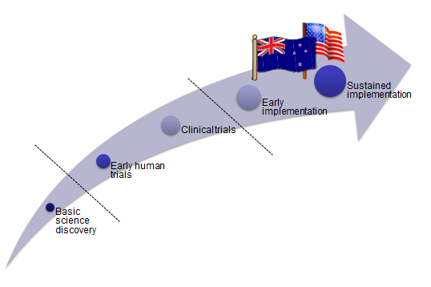
Translating evidence to practice
2010
Evidence-based supported employment established in New Zealand
Reliant on individuals
Not widely known about

Slide 6
A process of transformational change
Make the financial business case
(Purchasers)
International collaboration
Inform and inspire clinical leadership
Increasing access to employment support programmes in NZ
Embed in policy
Service user leadership
Monitor and evaluate impact and effectiveness
Keep sharing stories of success

Slide 7
Addressing the employment inequity
Research
Practice
Policy
Employment rates
Evidence-based intervention
Some early implementation
Rising to the Challenge

Slide 8
Sustained Implementation
Growing evidence base on effective implementation methods:
Dissemination of information alone is not enough
Training alone is not enough
Regular review practice against the evidence
Role of the change agent - purveyor(s) - State Trainer
Fixsen et al 2006

Slide 9
Addressing the employment inequity
Research
Practice
Policy
Implementation evidence: role of State Trainer
Sustained implementation
Further policy and systems development
Employment rates
Evidence-based intervention
Some early implementation
Rising to the Challenge

Slide 10
Cultural change
“I’m a bit embarrassed really. When (the employment specialist) first came to our team I thought, what are they here for? We work with people who are really ill, you know? But they showed me I was wrong. I refer people now who say they want to work even if I think it’s impossible for them to ever get a job as I’m constantly proved wrong”. Psychiatric Nurse

Slide 11
Improving physical health outcomes

Slide 12
Equally Well
A collaboration of people and organisations taking action to improve physical health outcomes for people who experience mental health and addiction issues
www.tepou.co.nz/equallywell

Slide 13
Addressing physical health
Evidence review

Slide 14
The Facts

Slide 18
Addressing physical health inequities
Evidence review
Position paper
Summit
Share examples of good practice
Priority health group
UK: parity of esteem

Slide 19
Are we making an impact?

Slide 21
Primary Care Options Tairawhiti
Everyone who is under the care of the specialist adult community MH&A teams will have 6 funded primary care visits a year for physical healthcare.
Everyone who is transitioning from specialist services will receive 4 extended GP visits and 4 normal GP visits plus between 12-26 practice nurse visits
Each general practice has eight 30 minute sessions per year with a consultant psychiatrist.
This initiative is a partnership between TDHB, Midlands Health Network, Ngati Porou Hauora and National Hauora Coalition as well as the local NGOs, Recovery Solutions, Turanga Health and Te Kupenga Net Trust

Slide 22
Thank you
Helen.lockett@wisegroup.co.nz

