Slide 1
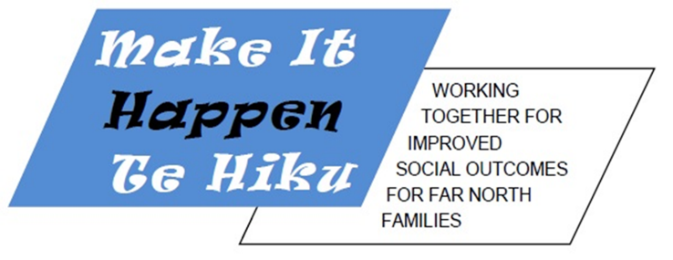
How our community is using RBA and Collective Impact to achieve community-wide wellbeing

Slide 2
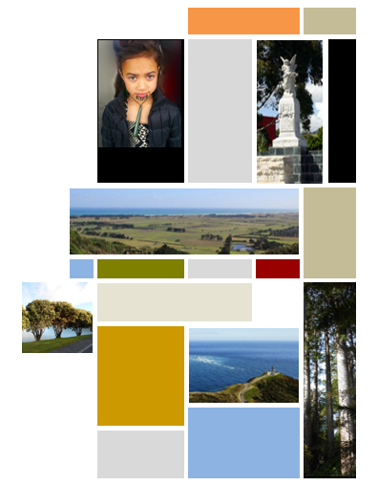
E tu ki te kei o te waka
Kia pakia koe e nga ngaru o te wa
Stand at the stern of the canoe and
Feel the spray of the future biting at your face

Slide 3
A place-based, community-driven collaboration for wellbeing

Slide 4
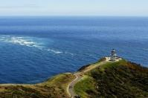
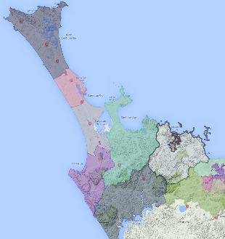
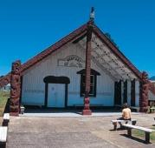
Te Hiku o Te Ika
Te Hiku has a population of 22,130, which is 40 per cent of the Far North District.
Iwi of Ngati Kuri, Te Aupouri, Ngai Takoto, Te Rarawa & Ngati Kahu
48% Māori, larger proportion of Māori than nationally
More of us speak Te Reo Māori compared to national figures
Considerably fewer of us were born overseas

Slide 5
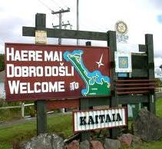
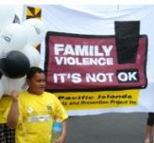
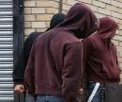
Our challenges
We have lower personal, household and family incomes than the national median
We have more sole parent families than nationally. About 33% of households in Kaitaia are sole parent compared to 22% for the Far North District and 18% nationally
More of us are receiving some form of income support in 2013 than in 2011
We have a lower level of employment, and a higher unemployment rate than nationally
Our access to technology – landline or cellphones, internet – is not as good as the rest of the country
We are less likely to own the home we live in
Our levels of achievement in educational qualifications are lower than national figures.

Slide 6
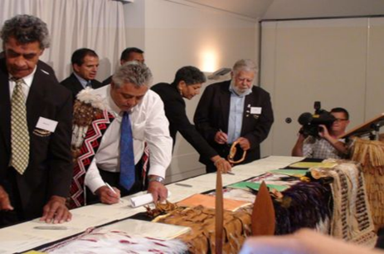
Iwi-Crown Social Accord
Te Hiku o Te Ika Iwi signed with the Crown on Waitangi Day, February 6th 2013
The Accord sets out the structures and relationships that will guide the parties in their collaboration to improve the social circumstances of Te Hiku o Te Ika Iwi, hapu, whanau and the wider community
25 year agreement
Corner stone of Treaty settlement redress
Effecting Positive Change

Slide 7
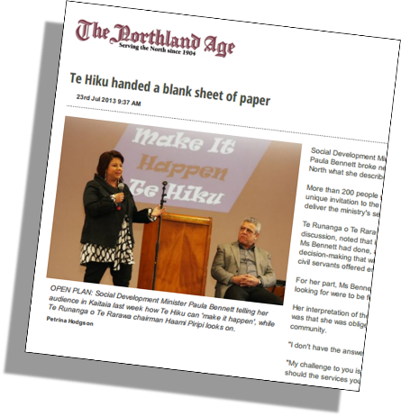
Crown invitation
"My vision is that you do the work and I give you the resources to do that. I bring you the power of my office, and happily and humbly hand it over to you. Look beyond the now; what is the vision? The way it's always been done doesn't have to be how it's done now…
"What's working and what's not? The truth is, I don't know. What I do know is that we can do better. I reckon we can make it happen, and fundamentally make a difference for the youth, tamariki and whānau of the
Far North."

Slide 8
Our Response
6
months
Ministerial launch of the project
Project Action Group
Introduced RBA and Collective Impact thinking
Community-led visioning – surveys, focus groups, one-on-ones, café groups
Designed community outcomes and indicators
Validated community outcomes framework with community sign-off
Population turn the curve workshops
Drafted Make it Happen Te Hiku Report
Launched report
Training
2.5
months
Training
Facilitator
Facilitator

Slide 9
Results Based Accountability
Make It Happen Te Hiku Project
Result, Indicator(s) & Strategies
Service & client outcomes
Initiative & client outcomes
Result, Indicator(s) & Strategies
Service & client outcomes
Population Accountability
Performance Accountability
ENDS
MEANS
Notes:
PART OF HOW!
One we had the community and indicators we held a series of meetings and brought together:
Community people
NGOs
Agenises
Iwi members
We trained the whole room on RBA 101
We then facilitated workshops asking 7 RBA questions and harvested Strategy ideas.
We went around and did further consultation and finalised the report/plan
These ideas were captured in the Draft MIHTH Report/plan provided to the Minister in 23 December 2013.
In January the Minister provided feedback and was pleased with the draft. She shared this across her colleagues and sought their support and feedback.
The report was provided to government CE’s in Wellington -- further feedback came back and support for the initiative.
All agencies are interested and want to know how we can progress this further.

Slide 10
RBA and Collective Impact
Twin platforms for collaboration and a common purpose
COMMON AGENDA
Community-owned population outcomes
MUTUALLY REINFORCING ACTIVITIES
Shared Action Plan (population level)
Action Clusters (population & performance)
BACKBONE FUNCTION
Ministry of Social Development
SHARED MEASUREMENT SYSTEM
10 x common indicators
Developing and mapping performance measures across region
CONTINUOUS COMMUNICATION
Ministerial appointed governance group (Taskforce)
Communications plan
Use 7 questions

Slide 11
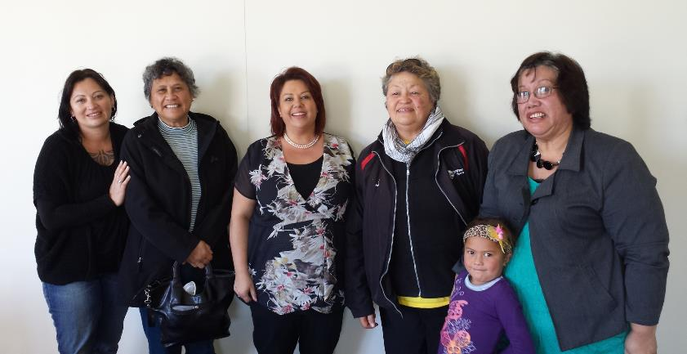
We recruited 50+ volunteer community facilitators
Notes:
At the launch we requested the support of the community by way of volunteering to capture the voices of the people who would not typically be heard.
We trained volunteers to become facilitators to conduct workshops in their own locations. We trained them in the RBA framework to get and understanding of how we are creating a common language.
We developed a database on reach and locality and matched volunteers with those areas.
During this process people have realised they are not just stakeholders, but game changers.
While the Social Accord is about long term sustainable change, Make it Happen Te Hiku is recent, real, it’s now and has captured hearts and minds and helped us see what we can achieve for ourselves.

Slide 12
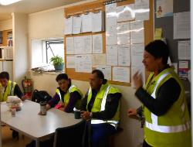
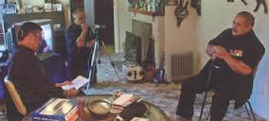
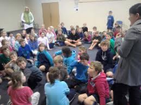
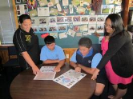
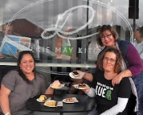
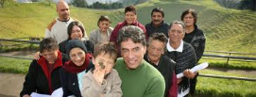
Our Community was engaged
on marae
in schools
at workplaces
at the kōhanga
at the cafe
via Volunteer Facilitators
with whānau
wherever it suited people…
Notes:
We had an incredible level of engagement. More than 2000 people were engaged and 1250 took part, including 600 young people.
Over two months, adults, young people and children met on marae and in homes, schoolrooms, church halls, workplaces and community halls. One discussion even took place on a school bus.
Talk about the childrens concerns - hunting fishing etc
Jobs – wealth creation

Slide 13
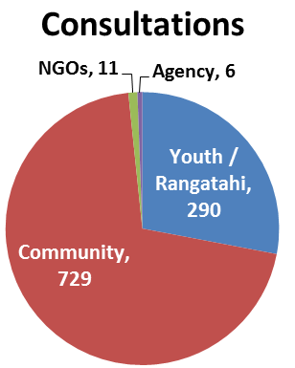
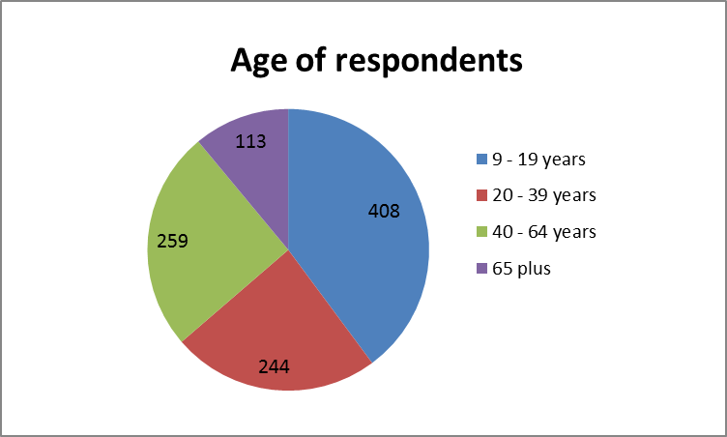
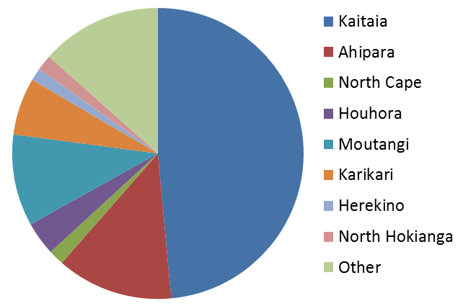
Our community responded
1250 people responded
Where living
Notes:
Their feedback was used to create a community action plan. The plan talks of more jobs, safe and healthy children, quality education, growing businesses, safe places and activities for young people, less crime, alcohol and drugs, more connection with marae and cultural roots, and better services for remote communities.

Slide 14
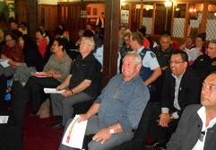
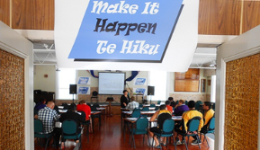
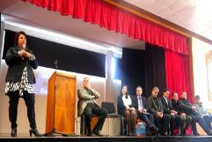
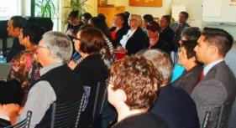
Multiple partners needed to work together
Government
Local
Regional
Iwi (Maori tribes)

Slide 15
And they told us…
the population outcomes they want and the indicators to measure success ….
Notes:
From there we analysed the anecdotal responses which broke down into many themes.
These were cross-referenced them from which we get our 5 community outcomes.
There are two indicators per outcome
We then held a series of turn the curve workshops hosting at least 90 people from community, agencies, central, regional and local government. These turn the curve exercises harvested strategy ideas for each of the indicators that where included in our community plan/report.
Agreeing on the ends in RBA language and shared population indicators
Recall Kiwi count for environment

Slide 16
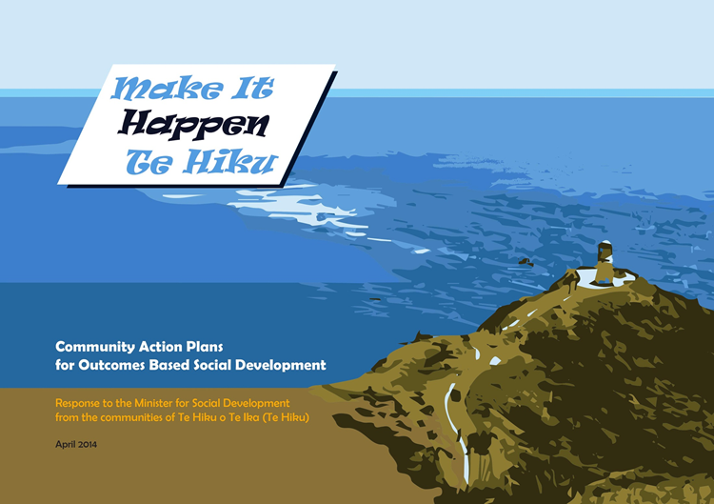
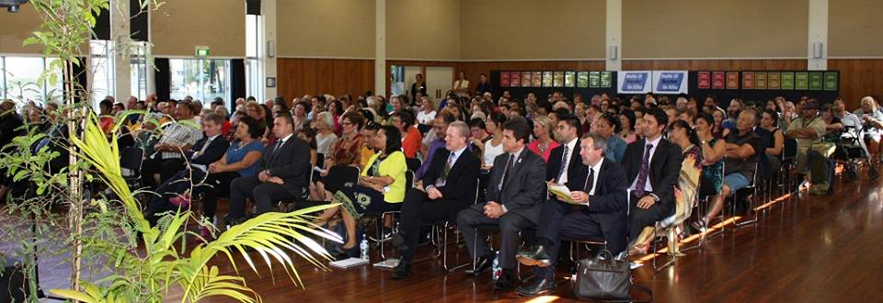
Community Report
1 April 2014
Notes:
Minister Bennett was supported to receive the report and was accompanied by Minister English (Finance). It was a great afternoon!

Slide 17
Project timeline
      November
      October
      September
      August
      July
      June
      May
      April
      March
      February
      January
      Taskforce: your task starts here!
      Make It
      Happen
      Implementation
27 June
First TF Meeting
1 April
Comm. Response. Report to Minister
      Phase 2:
      Consult
      Report writing
      Analysis
      2014
      December
      November
      October
      September
      August
      July
      June
      May
      April
      March
      February
      January
20 Dec
Draft Report to Minister
Comm Engagement
August - 7 October
7 Oct Consult deadline
      Phase 1:
      Engagement
17 Jul Launch
Develop Terms of Reference
      Foundations
Assemble team
Te Hiku Accord signed
      2013
Notes:
Your job will be to work together to develop these ideas further – rational/ evidence
This will be part of the process to develop the implementation plan.
YOU ARE HERE!!!!
How did you get here?

Slide 18
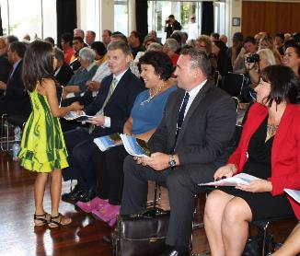
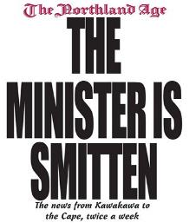
Highlights
Magnet!!!
Continuing to build community leadership, ownership and supports
Training staff and sharing staff
Connecting to other strategies and influential groups
Understanding everyone's drivers
Developing a framework of relationships and connections
Sharing a common Language
Volunteers and community insight
Notes:
All eyes on us, on this
Shifting attitudes and
Heading initiatives to a line of sight of outcomes
Developing a placed based framework to bring initiatives into to te Hiku that align to outcomes i.e. Health Families NZ

Slide 19
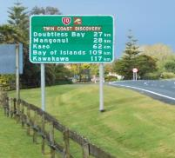
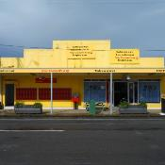
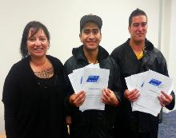
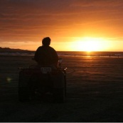
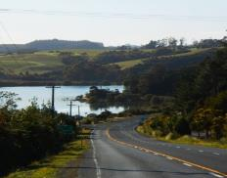
What's Working post the report
Moving from Ends to Means
Co-investment for outcomes
Collective impact groups
Collective initiatives and projects
Communication for Social Change Plan

Slide 20
Place Based
Make It Happen Te Hiku
Te Tiriti o Waitangi
POLITICAL DOMAIN
Article II
Article I
Treaty stakeholders
Iwi (=Hapu)
Crown (Govt.)
Community
Engagement instrument
Te Hiku Dvt Trust
MIHT Taskforce
Engagement vehicle
Te Hiku Social Dvt Accord
Ministries
MIHT Programme Team
Aligned outcomes framework
Outcomes
Outcomes
Outcomes
Article III
Purchasing and delivering services
Reports against
line of sight
DELIVERY DOMAIN
Outcome reporting
MIHT Director
Outcome reporting
Operational Leadership
COLLECTIVE IMPACT + Performance Accountability
Community, NGOs, Business Sector and Gov’t agency support:
MSD, NDHB, FNDC, MOE, MPI, DOC, TPK, Justice, Police, MBIE
Collaborative Implementation
Te Tai Tokerau Whanau Ora Collective
(Te Hiku): THoTHoTI, WOP, TRoTR
CoLab: Waitomo, TWRoM, NKSHS, AMTB, TRoTR
Leadership Groups/Project Managers
Culturally strong rich and proud
Peaceful safe and connected
Prosperous and progressive
Clean and Sustainable
Healthy and well
PAG:
Safer Communities Council, TRoTR ,TTPHO,Waitomo<, TRHoM, AMTB, Navilluso Ltd
Other partners: FNDC, FNReap, Sport Nthld.
He Korowai etc
Delivery Framework
Optimise impact through ‘joined-up’ programmes and services.
Targeted social marketing
Health promotion workforce development
R&D. Evidence based innovation. Tools, resources, delivery models
Delivery Settings
Other community settings i.e. marae
Sports & leisure settings i.e. rugby clubs
Schools, ECE,
tertiary edn. settings
Work Places i.e. JNL, Forestry etc.
Notes:
We then developed a framework to bring together our collective efforts and understand the landscape we are working in and with who.

Slide 21
Why it will always be important to us
Whaea Saana Murray’s message to the New Zealand government (Crown) about protecting Māori rights and the future generations (mokopuna) of the indigenous peoples of Aotearoa/New Zealand

Slide 22
Nga mihi
Tupuna who set the platform
Communities of Te Hiku o Te Ika
NGO providers
Government agencies as partners
Iwi leaders
Hapu and whanau
Government Ministers and Ministry of Social Development senior leaders
Mark Friedman, RBA
Sharon Shea from Shea Pita and Associates
Project Action Group
Te Hiku Development Trust
Te Hiku Development Accord
Te Hiku Business Community
Northland Intersectoral Forum
Far North and Regional Councils

Slide 23

Sheridan Waitai - Strategic Lead
Make It Happen Te Hiku
Ministry of Social Development
Sheridan.waitai006@msd.govt.nz
Link to the Make It Happen Te Hiku initiative: https://www.msd.govt.nz/about-msd-and-our-work/newsroom/media-releases/2014/make-it-happen-te-hiku-community-report.html

