Slide 1
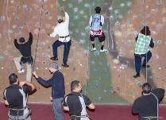
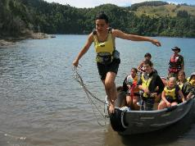
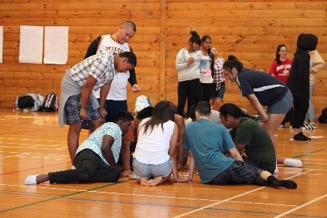
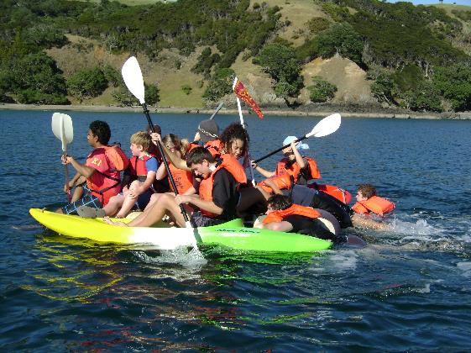
A Story of Evidence, Evaluation, and Partnership

Slide 2
Start of Our Evaluation Journey
Need for evidenced-based practice
Need to understand whether an intervention is effective and why?

Slide 3
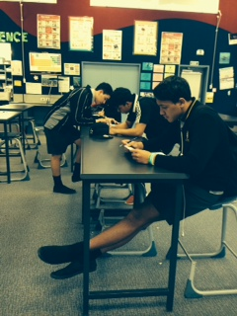
Building Knowledge and Credibility
Building credible and rigorous evidence
Commitment to inquiry and learning
Building research partnerships

Slide 4
FYD University Partnerships
Interest in external research
Extensive database of information
Limited time and resource to analyse data
Interest in knowing why, for whom and under what conditions programmes works
Interest in applied youth development research
Interest in producing a useful evaluation
Access to research resources
Statistical expertise

Slide 5
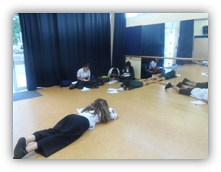
The Stars Journey
Positive benefits for mentees
“Facing fears, this really made me more confident in myself and feeling awesome…Getting along with other people; this has made me feel confident between my new friends & teachers. Working as a team makes everything easy.”
Positive benefits for Peer Mentors
“It has taught me a lot of leadership skills that I didn’t previously have. It has taught me you must be patient and tolerant, as well as learning new skills I have made friends with the Year 9’s and helped create friendships between the Year 9’s which makes me feel I achieved a lot through the STARS programme.”
Self-report surveys from mentees and Peer Mentors

Slide 6
University Student Partnership
Ethics, MoU and Confidentiality Agreements
Building knowledge
School-based mentoring can encourage school engagement
Stars incorporates many of the components of best practice and Lerner’s “Five Cs” of Positive Youth Development.
Positive benefits for mentees
Youth from low decile and predominantly Pasifika schools are more highly engaged.
K Noonan, P Bullen & S P Farrugia (2012). School-based mentoring: Examining the cultural and economic variations in engagement and effectiveness. New Zealand Journal of Educational studies. Vol 47, No 1.

Slide 7
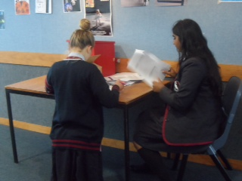
University Research Collaboration
2013 – 2015
FYD’s Research & Evaluation Team & the University of Auckland’s School of Counselling, Human Services & Social Work developed and conducted in collaboration:
Research Proposal Grant Application
Project design
Data collection and analysis
Reporting and Dissemination
Regular research team meetings

Slide 8
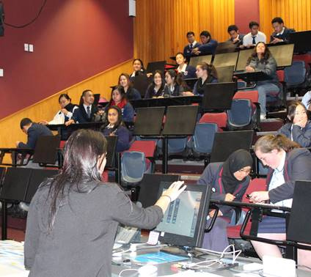
Outcomes and Opportunities
Upskill and build research knowledge and skills
Peer mentor involvement (results interpretation workshops)
“I learnt a lot more of what FYD means and what youth from all over the country's feelings are towards STARS. This project also enabled me to have the chance to give my opinions on the FYD programme.”
New information on impact of peer mentoring
Applied Practical Research
Evidence-based information
Improve programme and delivery
Enhance ability to recruit and retain mentors
Improve understanding of programme benefits
Improve experience for mentors, mentees, delivery staff and schools
Help secure future funding

Slide 9
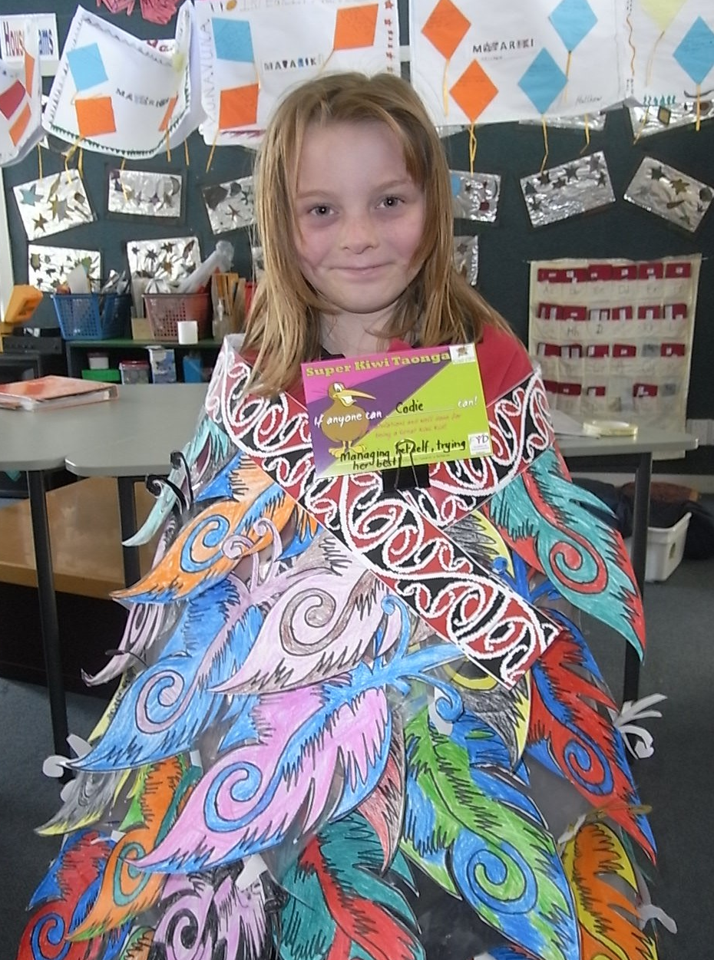
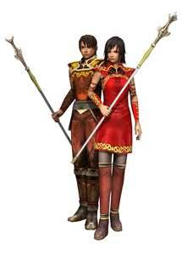
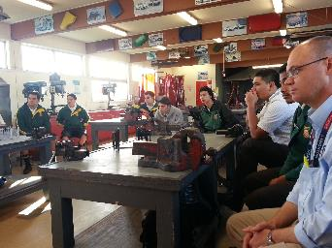
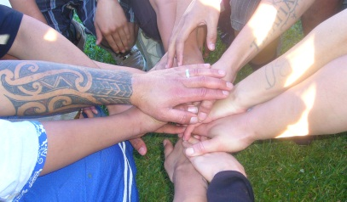
Key Projects
Project K, Stars, Kiwi Can, MYND, Career Navigator

Slide 10
Building Knowledge and Credibility
Building credible and rigorous evidence
Commitment to inquiry and learning
Building research partnerships
Internal Evaluations and consultation
Student Led Projects
University PhD Partnerships
Research Project Collaborations
Collaborative Practice Learning

Slide 11
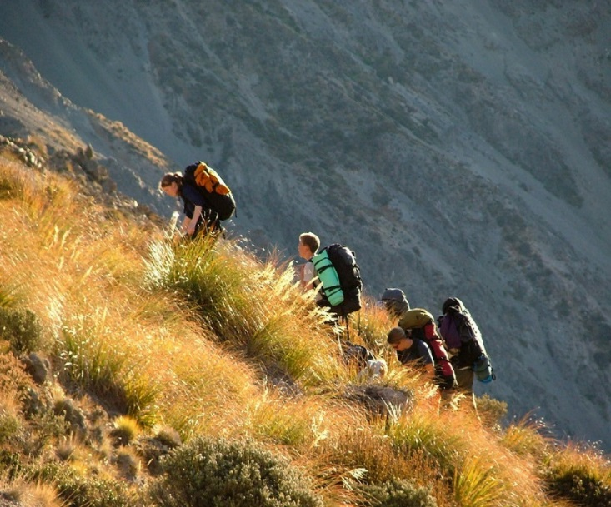
Lessons from our Evaluation Journey
Evaluating the programme theory is as critical as evaluating programme outcomes
Producing a “gold standard” programme evaluation takes more than a rigorous scientific design
Balance best evidence with practicality
Research partnerships create new knowledge, skills, insights for all involved
Learning and knowledge focus can strengthen links with other youth focussed organisations
A commitment to inquiry and learning builds knowledge and a shared understanding, and reveals new questions

Slide 12
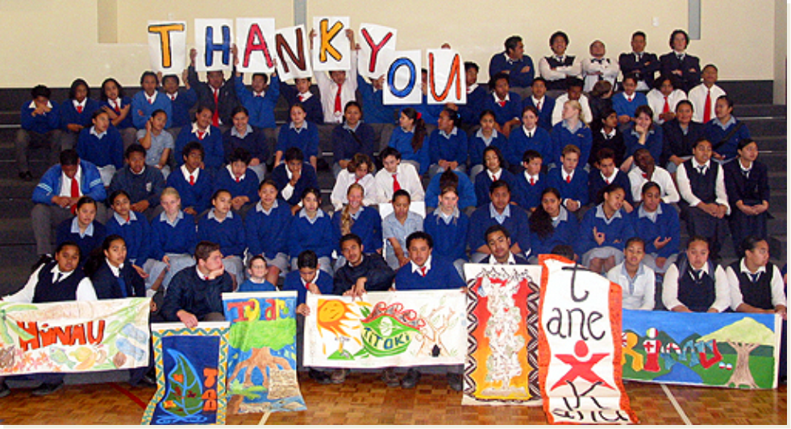
Lessons from our Evaluation Journey
Thank You

