Slide 1


Presentation to the ACC Policy Team
June 2015
Copyright (c) ACC

Slide 2

Overview
Mates & Dates is a best practice, multi-year programme designed for all secondary school students across years 9-13. It includes a mix of interactive activities intended to build strengths-based skills year-on-year.
Mates & Dates is designed to not only increase knowledge and awareness of sexual and dating violence but to help to change attitudes and behaviours.
Mates & Dates focuses on the social and emotional aspects of having relationships. It teaches young people how to have relationships based on respect, negotiation and consent.

Slide 3


What does the programme include?
Each module has five key themes:
• healthy relationships
• skills and consent
• identity, gender and sexuality
• when things go wrong
• keeping safe together

Slide 4

What does the programme aim to do?
The objectives of the programme are to provide young people with:
the tools (both knowledge and skills) to establish and maintain healthy relationships
bystander and intervention skills where there is a risk of violence
help-seeking skills for themselves and their friends if they are experiencing or causing sexual or dating violence
support for existing social norms relating to respect, negotiation and consent in relationships.

Slide 5
Pilot Objectives
Test materials and delivery methods to find out what needed to be altered for ongoing delivery
Measure the effectiveness and impact of a best practice, school-based healthy relations programme and approach to delivery in order to inform future investment decisions
Help to understand the capacity and capability required to support a nationwide programme of this nature

Slide 6

Pilot
Mates & Dates was piloted in eight schools in the third term of 2014
One school in Northland, two in Auckland, one in the Wairarapa, one in Wellington, two in Nelson and one in Dunedin were part of the pilot
Schools ranged in decile from 2 through to 9
The programme was delivered to over 1800 students and 1268 students were involved in the evaluation

Slide 7
  Facilitators
Fourteen facilitators: seven male and seven female
Co-facilitation delivery model used
Facilitators were expected to have prior experience delivering sexual violence prevention material
Experience in working with young people was also a pre-requisite
Facilitators were required to be trained in working with survivors of sexual violence, or those with harmful sexual behaviour
Providers were required to provide supervision for their facilitators and also have an existing relationship with schools

Slide 8

Evaluation
Evaluation activities were conducted in the eight school pilot sites
Schools worked in different ways to select students or classes for inclusion in the pilot
The evaluation consisted of a pre and post programme survey for students, focus groups with students, parents, teachers and school staff.
Evaluators also observed delivery at multiple pilot sites.

Slide 9
Survey and impact results

Slide 10
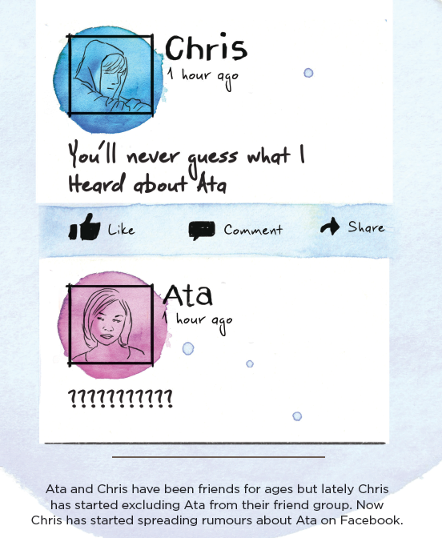
Survey
The main tool utilised for gathering primary data was the tablet survey, which was administered to participating students both prior to programme delivery and immediately after.
The post-programme survey contained additional questions on the experience of participating in the course.

Slide 11
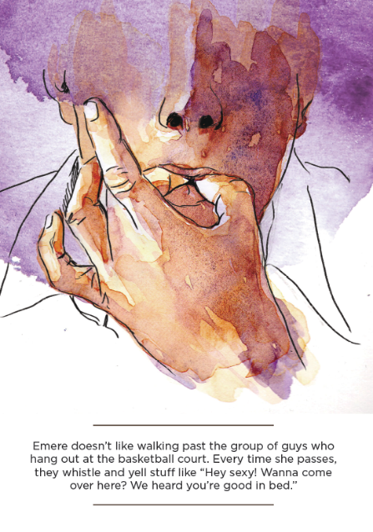
Notes about the survey
1268 students took the survey pre-programme, and 1149 undertook it post-programme.
Students were asked to generate a unique identifier for themselves (to protect their privacy)
Due to absences in the fourth school term due exam preparation, and issues matching the pre- and post- identifiers used by students (as many had forgotten their IDs), only 600 matches could be made - so only these 600 surveys were used to analyse the pre/post survey results.

Slide 12
Post-programme Survey Results
Attitudinal change is a long term proposition - changing behaviours is complex. However, the impacts from a pilot of this scale over this short period of time have been promising:
Increased knowledge was reported in recognising early warning signs of abuse, the effects of alcohol and their impact on relationships, and ability to manage risky situations.
There was an increase in reports of unwanted touching following programme participation (57 respondents to 65). This indicates more willingness to disclose.
There was a higher level of disagreement with rape myths, which is evidence of positive programme impact in this area
Knowledge of where to seek support improved
Most students indicated that they had learnt more about relationships and were more aware of how to develop healthy relationships
There was an increased level of disagreement with the list of gendered statements
More students indicated they were confident in recognising risky situations and risky behaviour
There was no significant difference in understanding of consent, but it is important to note that levels of understanding of consent were uniformly high pre-programme

Slide 13
Delivery and process findings

Slide 14
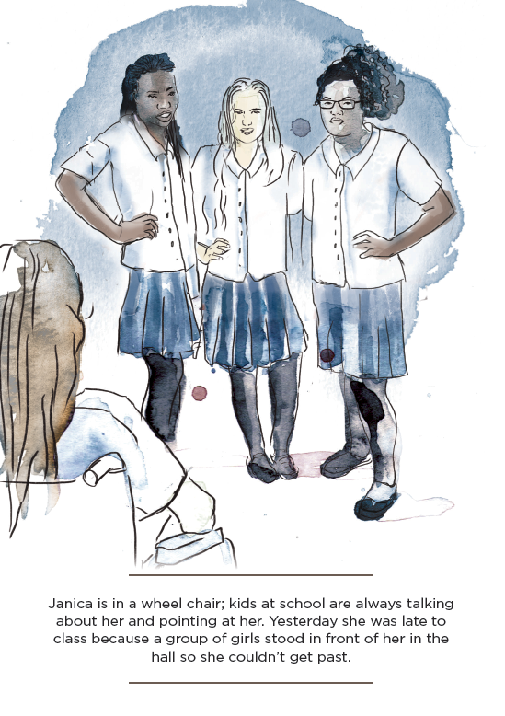
Facilitation
Co-facilitation model - having a male and a female presenter was helpful as both perspectives were given, and it showed gender equality and co-operation in action. As one school staff member said:
    “The co-facilitation model is superb….The kids need to see a good working relationship.
    They are modelling healthy relationships. It is also important for them to see that men can talk about these things”
Effective facilitators worked with the programme flexibly and customised their approach to fit the class

Slide 15
Areas for improvement
More emphasis on classroom teaching skills for facilitators is required
More interaction is required between facilitators and school staff to clarify roles and responsibilities
Some facilitators felt that they needed more training and preparation time
At some sites, only 40 minutes was allowed for each class. This meant that not all the course material was delivered in its entirety

Slide 16
Areas for improvement
  The programme was better received in schools that had an active ‘school champion’ i.e. a senior leader in a position of power and influence in the school
  Stronger ACC presence in pilot schools would have helped to manage relationships between the school and providers
  There needs to be longer lead in time with more pre-programme information disseminated from schools to students and whanau

Slide 17
Material and content findings

Slide 18

Cultural responsiveness
Kaupapa Maori
Some kaupapa Maori principles are implicit in this programme, but explicit references to Maori culture are absent.
Pasifika
There is little acknowledgment of the principles of Pacific society and culture in the programme.
People with disabilities
The lack of sub-titles for hearing impaired students was noted as an oversight.
The importance of including Information on how to work carefully and respectfully with those on the autism spectrum was also mentioned as an area for improvement.
GLBTI Communities
Evaluators noted the significant focus on diverse sexualities and sexual identities.
However, facilitator experience in working with GLBTI and capability in supporting their needs was mentioned as an area that could be improved upon

Slide 19

Questions?
19
Copyright (c) ACC

