Slide 1
Are we being held back? An exploration of how evidence is used to address complex social problems
Professor Kristy Muir - @KristyMuir2
Superu Evidence to Action Conference 2016 – Evidence: it’s how you use it that matters
Wellington NZ, 5 April 2016
v

Slide 4
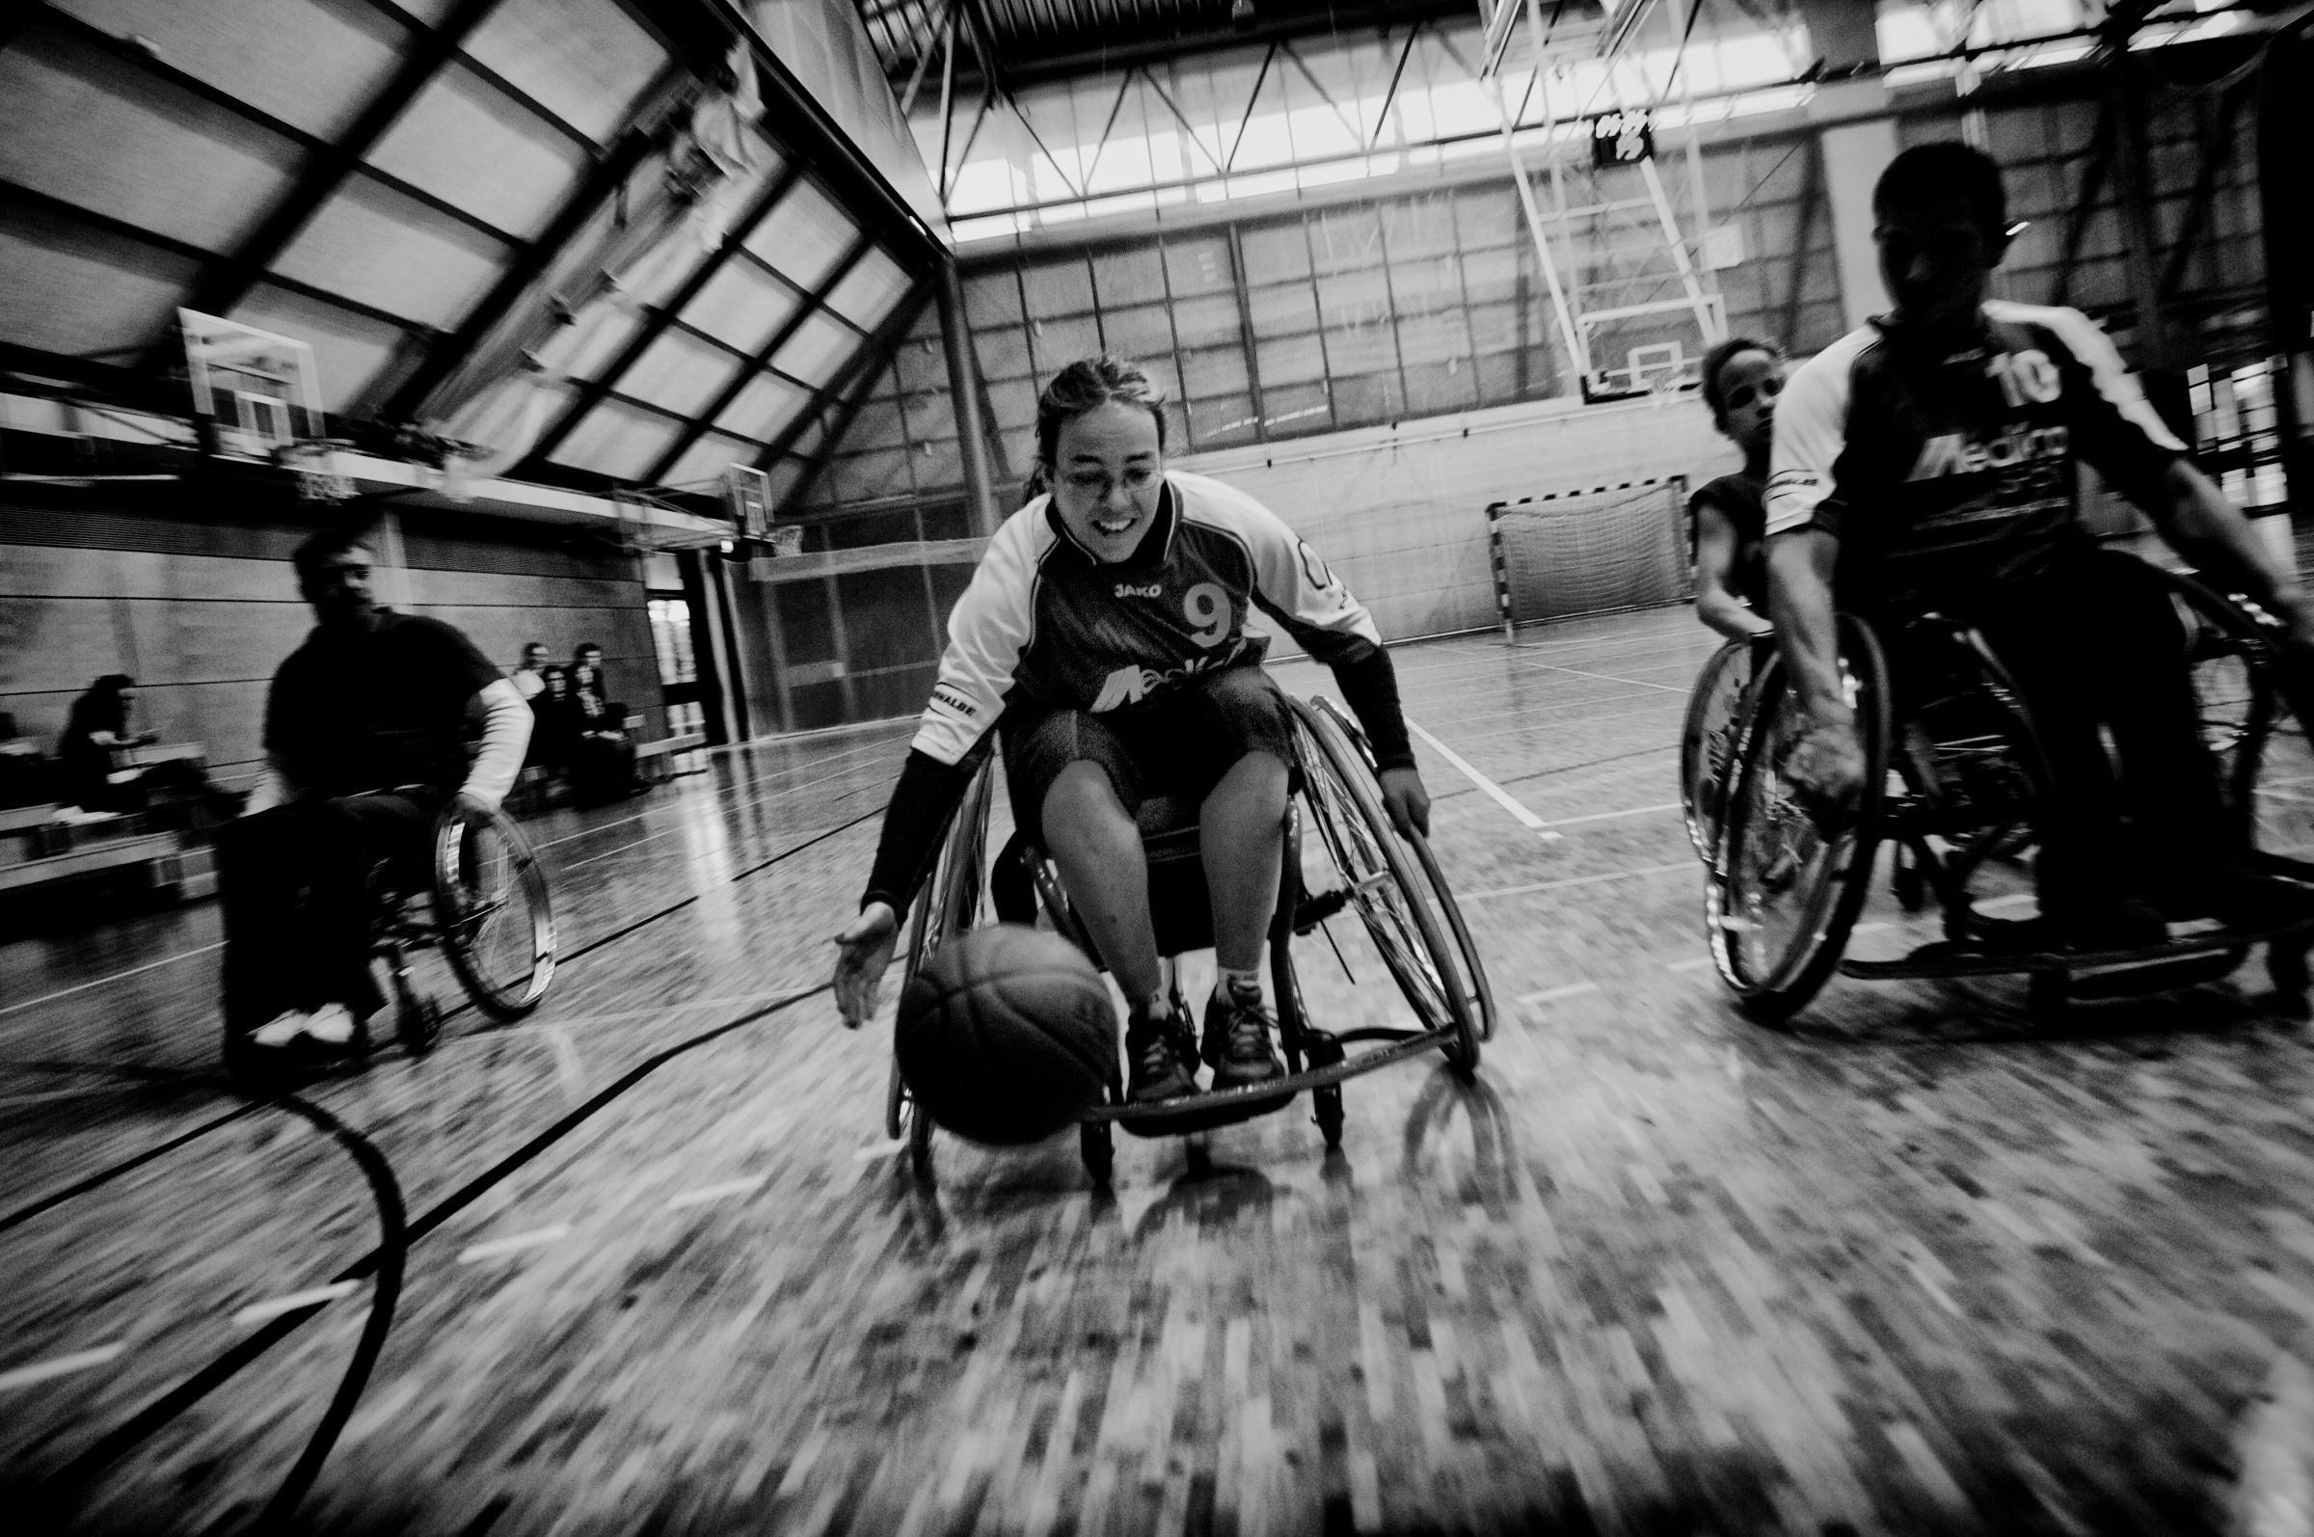

Slide 5
Social issues
Mental health & social and economic exclusion
Disability & economic exclusion
Homelessness
Indigenous v non-Indigenous gaps
Increased poverty & inequity
High levels of youth unemployment
Place based disadvantage
What if we lived in an era where policy decision, services and organisations were driven by using evidence effectively?
What might we achieve and what are the risks if we focus on outcomes based on that evidence?
What might this mean for social change for our children, young people, families and communities?

Slide 6
Funding and sector shifts
Notes:
If we’re not driven to do this to change outcomes, we’ll be pushed to do this by shifts in the sector and changing funding models…

Slide 7
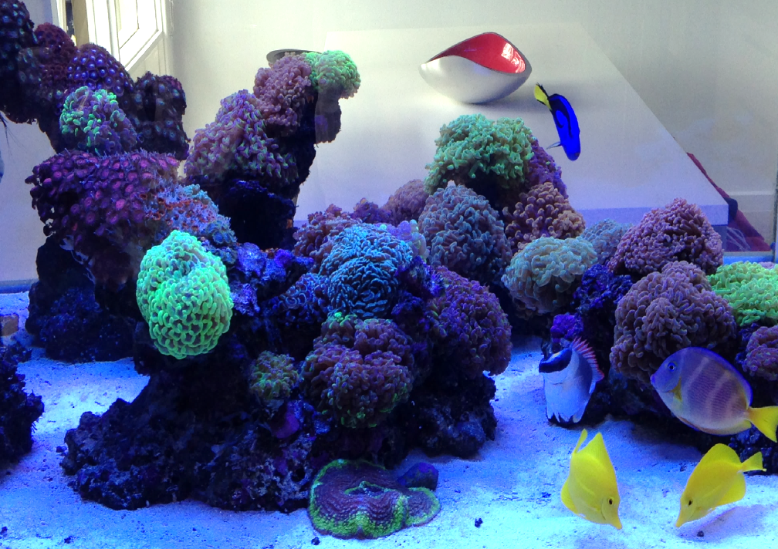
Different problems & Systems thinking
What type of problem are we trying to solve?
Linear (cause & effect)
Complicated
Complex
Systems thinking
Independent parts that play different roles
Parts “interconnected”: work together & interact
The whole is different from the sum of the parts
Feedback loops
Notes:
If we want to answer these questions: how to use evidence effectively, we need to work out what evidence to collect. A key part of this is working out what types of problem (or problems) we are trying to solve.

Slide 8
The system people live in & oecd goals
Personal security
Community infrastructure
Orgs, govt agencies , businesses, housing, transport, community groups
Family & friends
Other trusted friends, mentors, carers, networks etc
Characteristics, traits, SES, health, disability
Societal infrastructure & opportunities
Work, education, health
NFP, govt, corporates, philanthropy
Policy, governance, laws, culture
Environment
Social connections
Subjective well-being
Environmental quality
Health-status
Education and skills
Work-life balance
Civic engagement and governance
*OECD (2013), “The Better Life Initiative Concepts and Indicators”, How's life? 2013 - Measuring well-being, OECD Publishing
Notes:
Complex problems exist within systems. People live within systems and we need to understand what these problems are and how to think systemically to solve those problems and work out what evidence to draw on to determine how to address change.
I want to use the three people I introduced you to at the start to begin to set up 3 system thinking examples of complex social problems and where evidence has or hasn’t been used effectively to drive policy decisions, services and organisations.

Slide 9
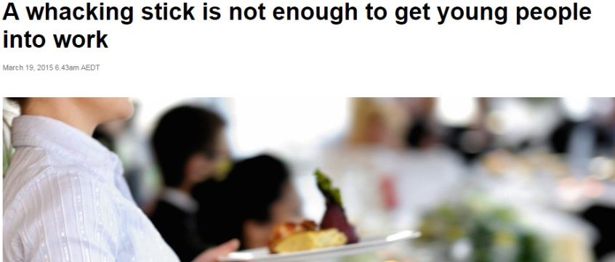
Jack: economic participation, mental health, youth
Community infrastructure
Orgs, govt agencies , businesses, housing, transport, community groups
Family & friends
Little to no trusted supports
YP, MH. AOH, social skills, low education
Societal infrastructure & opportunities
High youth unemployment
Urban area: so community resources
Policy, governance, laws, culture
Social security policies
Environment

Slide 10
Catherine: disability and participation
Community infrastructure
Currently living in urban area to access orgs, govt agencies , businesses, housing, transport, community groups
Family & friends
Family live in rural area
YP, disability, tertiary education
Societal infrastructure & opportunities
High unemployment amongst people with disability
Policy, governance, laws, culture
NDIS
Environment

Slide 11
Mae: Place based disadvantage
Community infrastructure
Orgs, govt agencies , businesses, housing, transport, community groups
Family & friends
Other trusted friends, mentors, carers, networks etc
Early childhood, low SES, poor development outcomes
Societal infrastructure & opportunities
Work, education, health
NFP, govt, corporates, philanthropy
Policy, governance, laws, culture
Environment
14% of NZ children living in material poverty & 29% in income poverty (Child Poverty Monitor, 2015)

Slide 12
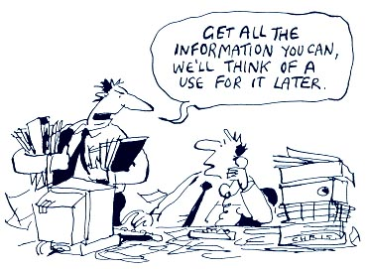
Some risks
Evidence is too driven by unsubstantiated costs and benefits (e.g. SRoI)
Not thinking systemically or about unintended consequences
Distraction of outcomes > failure to recognise the importance of:
Process
Establishment & implementation
Intermediaries
Funding
The market will not always provide
Risk losing niche providers/ supports
Hardest to reach and support may fall through the cracks
Poor data collection and use
Individual evaluations
Lack of transparency
Lack of comparability & shared measurement

Slide 13
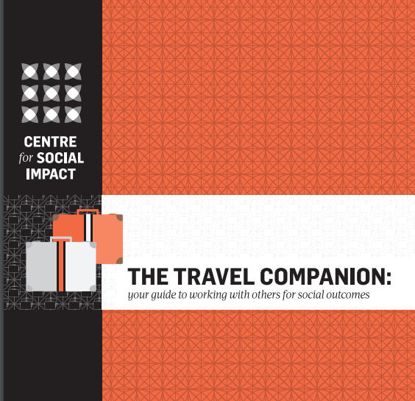
So what?
What problem needs to be solved?
Think & work systemically
What’s the system look like? What are the levers, feedback loops, unintended consequences?
What’s my role in the system?
Collaboration is critical when relevant
Who can I / should I be partnering with, under what circumstances & conditions?
Work within the competitive market (be ahead or keeping up with the curve)
What values/ concepts are driving change?
What funding mechanisms are available?
Measure what matters for people who matter
Use quality evidence to inform, keep, change and/or stop
Who matters most? What do they want/ need?
What numbers and what stories will have influence?
How do I best exchange knowledge with different audiences?
What happens when the evidence isn’t enough?

Slide 14
Contact details
Professor Kristy Muir (PhD)
Professor of Social Policy & Research Director
Suite 16.01, Level 16, 6 O’Connell St, Sydney NSW 2000 Australia
P +61 2 8936 0923 | M +61 478 492 114
E k.muir@unsw.edu.au
@CSIsocialimpact | WWW.CSI.EDU.AU

